Slide 1
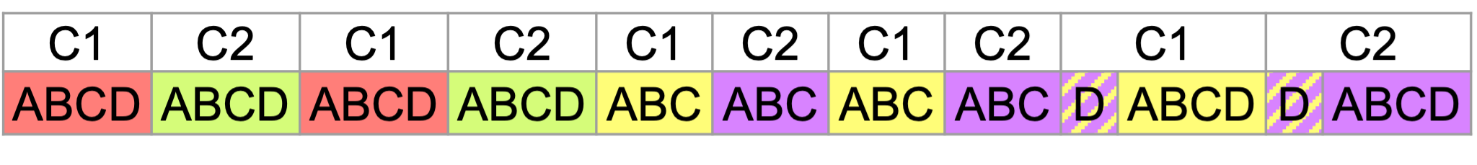
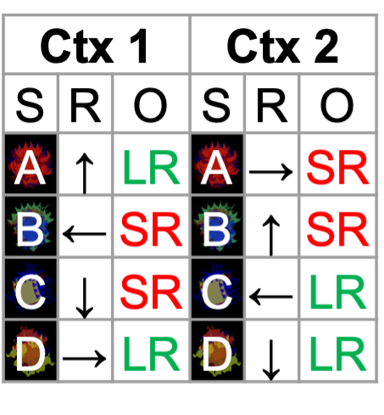
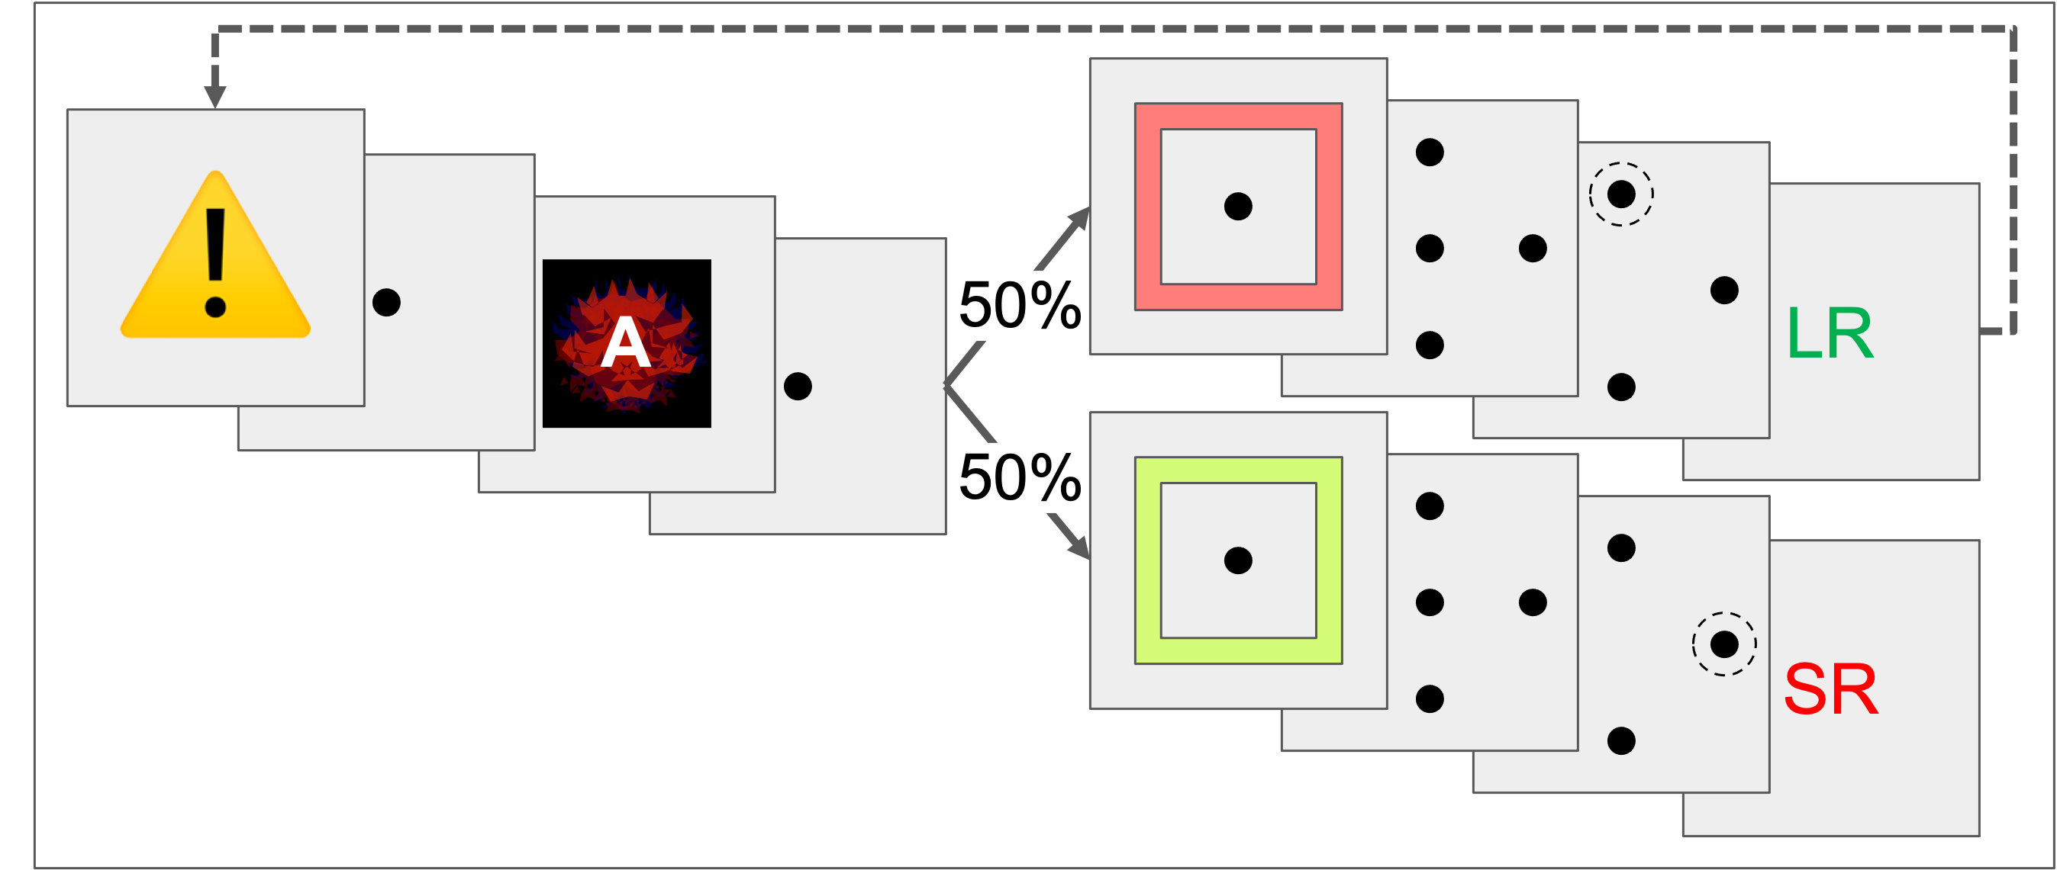
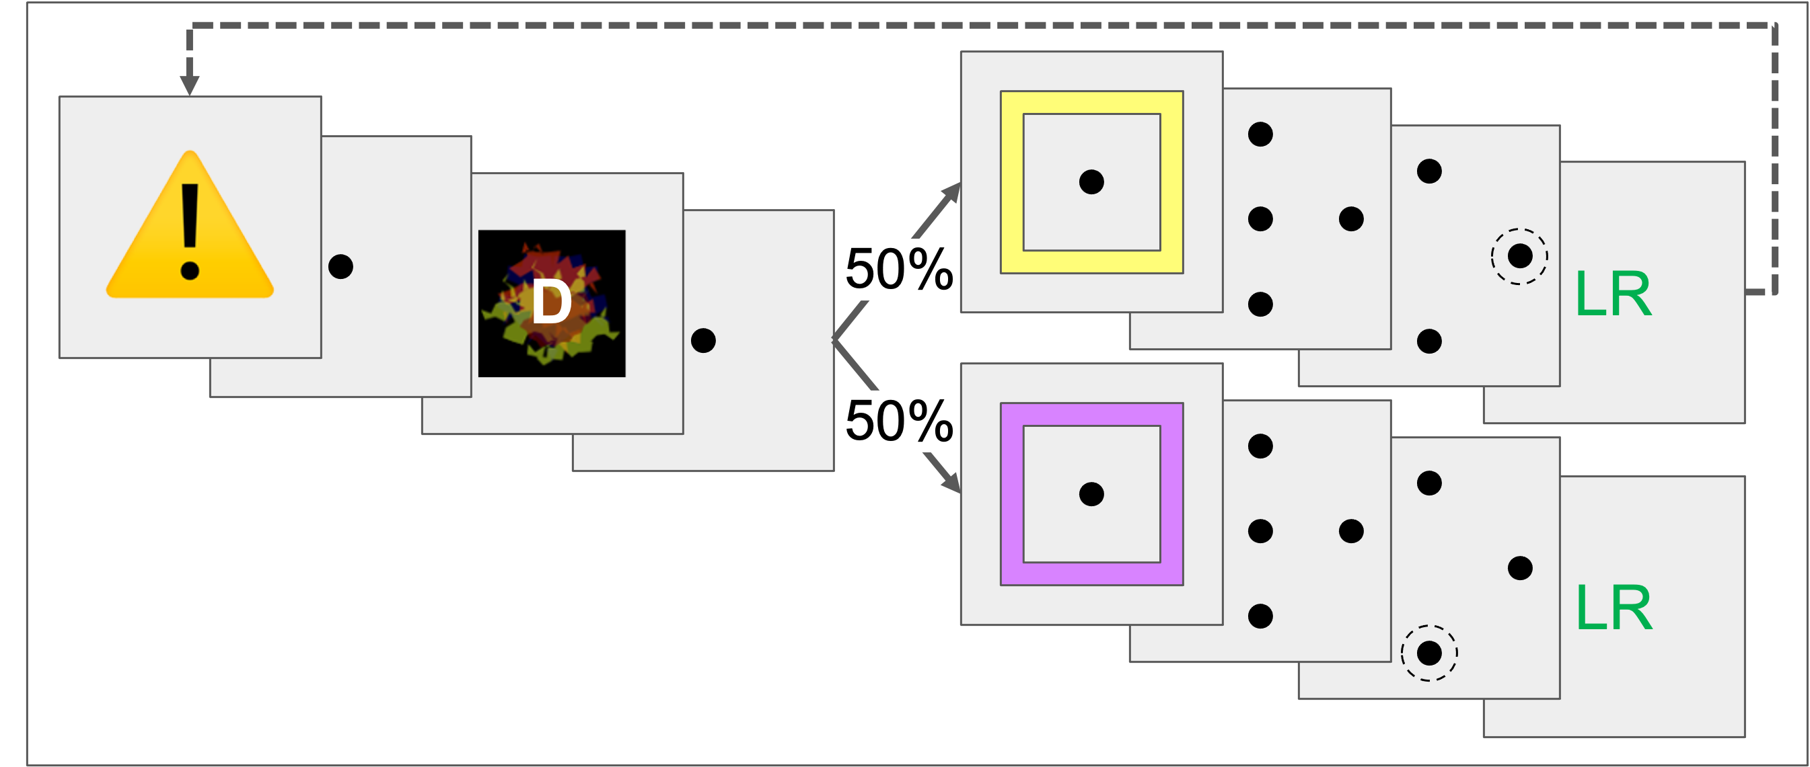
C1 → C2 : Flexibility Trials
C1 → C2 : Generalization Trials

Slide 2
C1 → C2 : Flexibility Trials
C1 → C2 : Generalization Trials

Slide 3
C1 → C2 : Flexibility Trials
C1 → C2 : Generalization Trials

